Slide 1
Priyanshu Dutta
AF05103859
IT MODULE

Slide 2
SL.NO. Context Page NO.
01 | Introduction to IT and Business Systems 3-8
02 | Data Types, Sources, and Lifecycle 9-14
03 | Introduction to Business Analyst Role 15-18
04 | Data vs. Information 19
05 | Overview of Data Driven Decision Making 20-21
06 | Case Discussions / Real Life Examples 22-23
07 | Introduction to Data Governance & Data Ethics 24-26
08 | Conclusion 27

Slide 3
01. Introduction to IT and Business Systems
Information Technology (IT) refers to the use of computers, software, networks, and digital systems to store, process, manage, and transmit information efficiently. It includes hardware like computers and servers, software applications like Excel and web browsers, networking systems that connect devices, databases that organize data, and cybersecurity measures that protect information from threats. IT plays a vital role in almost every industry such as banking, healthcare, education, ecommerce, and corporate offices by improving productivity, automating tasks, and supporting data driven decision making. In simple terms, IT is the technology that helps individuals and organizations handle information effectively in the digital world.

Slide 4
Business systems are organized processes and technologies used by companies to manage daily operations, support decision making, and achieve organizational goals. These systems combine people, procedures, software, and hardware to collect, process, and store information efficiently. Business systems help in areas such as finance, sales, marketing, human resources, inventory, and customer service. There are different types of business systems, including Transaction Processing Systems (TPS) for handling daily transactions, Management Information Systems (MIS) for generating reports, Decision Support Systems (DSS) for analyzing data, and Enterprise systems like ERP and CRM for integrating business functions. Overall, business systems improve productivity, accuracy, coordination, and help companies make better strategic decisions.

Slide 5
Role of IT in Business Operations
Information Technology (IT) plays an important role in business operations by improving efficiency, accuracy, and communication. It helps companies manage data, automate tasks like payroll and inventory, and use software systems such as ERP for smooth workflow management. IT also supports data analysis for better decision making, enables cloud based access to information from anywhere, and ensures data security. Overall, IT helps businesses reduce costs, increase productivity, and achieve faster growth.

Slide 6
ERP vs CRM
Enterprise Resource Planning (ERP) is a business management system used to integrate and manage core internal processes such as finance, accounting, human resources, inventory, procurement, and supply chain operations. It provides a centralized database that allows different departments to share information in real time, reducing errors and improving coordination. ERP systems help organizations streamline workflows, automate routine tasks, control costs, and increase overall operational efficiency. By using ERP, companies can track resources effectively and make better strategic decisions based on accurate internal data.

Slide 7
Customer Relationship Management (CRM) is a system designed to manage a company’s interactions with current and potential customers. It helps businesses organize customer data, track sales leads, monitor marketing campaigns, and handle customer service activities. CRM systems improve communication with clients, enhance customer satisfaction, and increase sales performance by providing detailed insights into customer behavior and preferences. While ERP focuses on managing internal operations, CRM focuses on strengthening customer relationships and driving revenue growth.

Slide 8
Business Strategy & IT Strategy
Business Strategy
Focuses on overall company goals and long term growth.
Defines market position and competitive advantage.
Decides products, services, and target customers.
Aims to increase profit and market share.
IT Strategy
Focuses on technology planning and digital transformation.
Supports business goals through IT solutions.
Manages infrastructure, software, and data systems.
Improves efficiency, security, and innovation.

Slide 9
02. Data Types, Sources, and Lifecycle
Types of Data :-
a) Structured Data
Organized in a fixed format like rows and columns.
Stored in relational databases (SQL) and spreadsheets.
Easy to search, filter, and analyze using queries.
Commonly used in business reports and MIS systems.
Example: Employee records, sales data, inventory lists.

Slide 10
b) Unstructured Data
Does not follow a predefined format or structure.
Difficult to store and analyze using traditional databases.
Requires advanced tools like AI or data analytics software.
Makes up a large portion of business data today.
Example: Emails, social media posts, images, videos, audio files.
c) Semi-Structured Data
Not fully structured but contains tags or markers.
More flexible than structured data.
Often used in web applications and data exchange.
Can be converted into structured format if needed.
Example: JSON files, XML documents, HTML files.

Slide 11
Data Sources
a) Internal Sources: Data generated within the organization, such as sales reports, employee records, and inventory data.
b) External Sources: Data collected from outside the company, like market reports, government data, and competitor information.
c) Primary Sources: Data collected directly through surveys, interviews, and observations.
d) Secondary Sources: Data already collected by others, such as research papers and online reports.

Slide 12
Data Collection Methods
a) Surveys & Questionnaires: Collect data from a large number of people using online or offline forms. Useful for gathering opinions and feedback.
b) Interviews: Direct interaction with individuals to collect detailed and in depth information.
c) Observation: Collecting data by observing behavior, processes, or events in real time.
d) Experiments: Testing under controlled conditions to study cause and effect relationships.
e) Automated Data Collection: Using software, websites, sensors, or systems to collect data automatically (e.g., website analytics, app data).

Slide 13
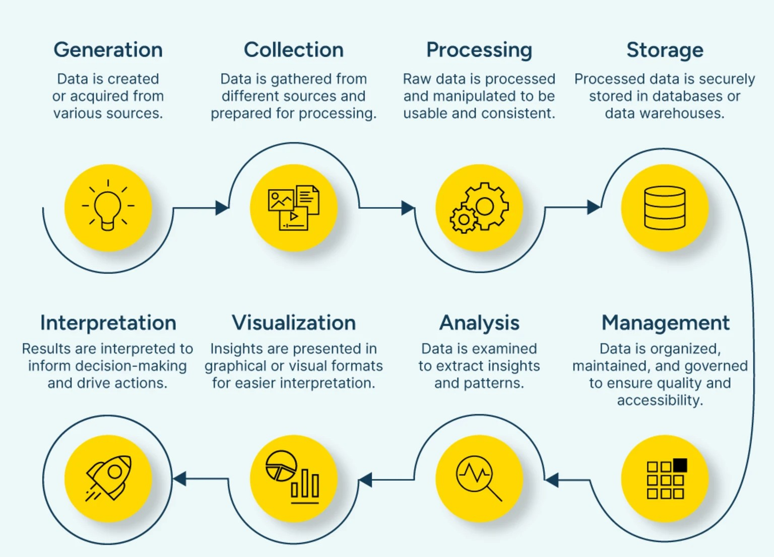
Data Lifecycle Management

Slide 14
Stages are :-
a) Data Creation/Collection: Data is generated from sources like transactions, surveys, or systems.
b) Storage: Data is stored in databases, cloud systems, or data warehouses.
c) Processing/Usage: Data is analyzed and used for reporting and decision making.
d) Sharing: Data is shared across departments or with stakeholders when required.
e) Archiving: Old or inactive data is stored securely for future reference.
f) Deletion/Destruction: Data is permanently removed when it is no longer needed.

Slide 15
03. Introduction to Business Analyst Role
A Business Analyst (BA) is a professional who identifies business needs and helps design effective solutions by bridging the gap between business teams and technical teams.
Key Responsibility :-
Gather and analyze business requirements.
Communicate between stakeholders and developers.
Prepare documentation like BRD and reports.
Analyze data to support decision making.
Suggest process improvements to increase efficiency.

Slide 16
Key Skills :-
a) Analytical Skills
b) Communication Skills
c) Problem-Solving Skills
d) Technical Knowledge
e) Documentation Skills
f) Stakeholder Management

Slide 17
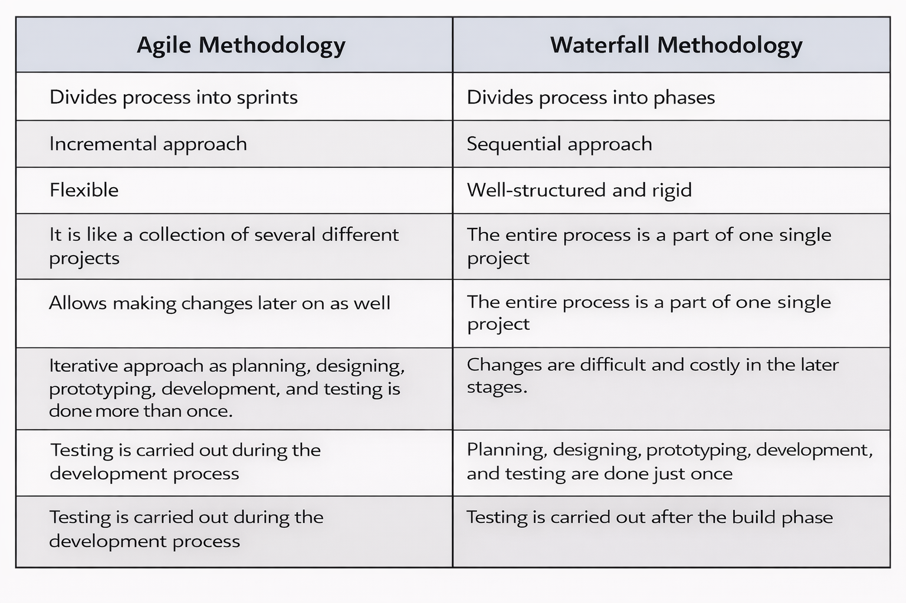
Agile vs Waterfall Method

Slide 18
Stakeholder Management
Stakeholder Management is the process of identifying, analyzing, and engaging people or groups who have an interest in a project or business activity.
Key Activities :-
Identifying stakeholders (clients, managers, team members, investors)
Understanding their needs and expectations
Communicating project updates regularly
Managing conflicts and resolving issues
Ensuring stakeholder satisfaction and support
Importance :-
Improves communication and collaboration
Reduces project risks
Increases chances of project success

Slide 19
04. Data vs. Information
Data
Raw facts and figures without context.
Unorganized and unprocessed.
May not give clear meaning on its own.
Example: 100, 200, 300.
Information
Processed and organized data.
Meaningful and useful for decision making.
Provides context and understanding.
Example: Sales increased from 100 to 300 units in 3 months.

Slide 20
05. Overview of Data Driven Decision Making
Steps:-
a) Define the Problem: Clearly identify the business issue or objective that needs a decision.
b) Collect Data: Gather relevant data from internal and external sources.
c) Clean & Organize Data: Remove errors, duplicates, and arrange data properly for analysis.
d) Analyze the Data: Use tools like Excel, SQL, or BI dashboards to find trends and patterns.
e) Interpret Results: Understand what the data insights mean for the business.
f) Make the Decision: Take action based on the insights gained from the analysis.
g) Monitor & Review: Track outcomes and adjust strategies if necessary.

Slide 21
How It Works?
Collect data from various sources (sales, customers, operations).
Analyze the data using tools like Excel, BI dashboards, or analytics software.
Interpret the results to identify trends and patterns.
Make informed decisions based on insights.
Importance
Reduces risks and uncertainty.
Improves accuracy and efficiency.
Helps identify opportunities and problems.
Supports strategic planning and business growth.

Slide 22
06. Case Discussions / Real Life Examples
Scenario Analysis is a decision making technique used to evaluate possible future outcomes by analyzing different “what if” situations. It helps organizations understand risks, opportunities, and the impact of various assumptions before making decisions.
How It Works?
Identify a key decision or problem.
Create different possible scenarios.
Analyze the impact of each scenario.
Choose the most suitable strategy.

Slide 23
Example :-
A company plans to launch a new product.
Best Case: High demand - 30% profit increase
Most Likely Case: Moderate demand - 15% profit increase
Worst Case: Low demand - 5% loss
By analyzing these scenarios, the company can prepare marketing budgets, manage risks, and plan inventory accordingly.

Slide 24
07. Introduction to Data Governance & Data Ethics
Data Governance refers to the policies, processes, and standards used to manage data within an organization. It ensures that data is accurate, secure, consistent, and properly used. Data governance defines who can access data, how it is stored, and how it is maintained throughout its lifecycle.
Data Ethics involves the moral principles and guidelines that govern how data is collected, shared, and used. It ensures that data is handled responsibly and fairly without harming individuals or violating privacy.

Slide 25
Ethical use of Data
Key Principles :-
Consent: Collect data only with the user’s permission.
Privacy Protection: Keep personal information secure and confidential.
Transparency: Clearly inform users how their data will be used.
Fairness: Avoid bias and discrimination in data analysis.
Accountability: Take responsibility for data misuse or breaches.

Slide 26
GDPR vs CCPA
GDPR :
General Data Protection Regulation.
Applies in the European Union.
Protects personal data of EU citizens.
Requires clear user consent before collecting data.
Heavy penalties for non compliance.
CCPA :
California Consumer Privacy Act.
Applies in California, USA.
Protects personal data of California residents.
Gives users the right to opt out of data selling.
Penalties for businesses violating consumer rights.

Slide 27
08. Conclusion
Use of Information Technology leads to faster and more accurate business decisions.
IT systems like ERP, CRM, and analytics tools improve efficiency and reduce operational errors.
Data driven decision making minimizes risk compared to decisions based only on intuition.
Technology enables better planning, forecasting, and competitive advantage.
Organizations that effectively integrate IT with business strategy achieve sustainable long term growth.

